Slide 1
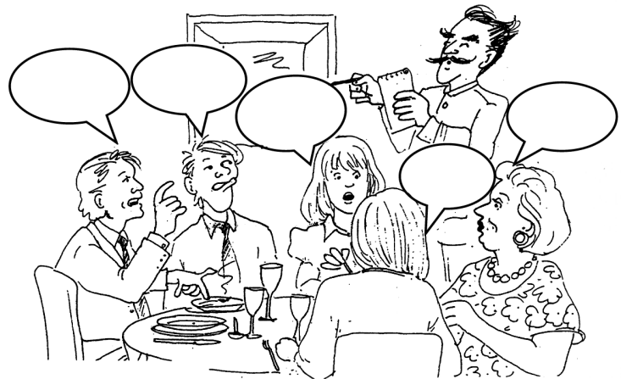
GROUP WORK: TIPS

Slide 2
Listen actively
Establish a common goal
Assign roles
Create a timeline
Outline your objectives
Divide and conquer
Be wary of “groupthink”
Resolve conflicts quickly and fairly

